Slide 1


Slide 2


Slide 3

Legal Articulation
Instructor:
Date:

Slide 4
OBJECTIVES
Topic: Legal Articulation
Objectives: (Classroom)
Identify and utilize the Canadian Criminal Code
Understand subject resistance model
Understand Use of Force Framework
Understand the elements of effective use of force

Slide 5
OBJECTIVES
Method Of Instruction: Lecture development, practical application, written exam
Training Aides: Lecture, Video, Exam
Pen and paper are required

Slide 6
Introduction
Legal Articulation allows Security to explain what happened:
Before
During
After
use of force encounters

Slide 7
Introduction
Most people do not want to engage in physical encounters, nor have been involved in any
Security’s goal is much the same, to deal with people without resorting to physical control
Often times society’s perception of use of force is often tainted through media and TV.

Slide 8
Introduction
Security’s use of force is designed to:
Gain control using no more force than is necessary.
Allow for Officer Safety
Minimize harm to the subject

Slide 9
Accountability
When using force there are three levels of Accountability
1. Criminally
Canadian Criminal Code
2. Civilly
Tort Law
3. Internally
Company policy and procedure

Slide 10
Accountability
Regardless of the incident:
1. Force used must be reasonable
2. Are your actions what a reasonable, well trained security agent, would do when faced with a similar situation?

Slide 11
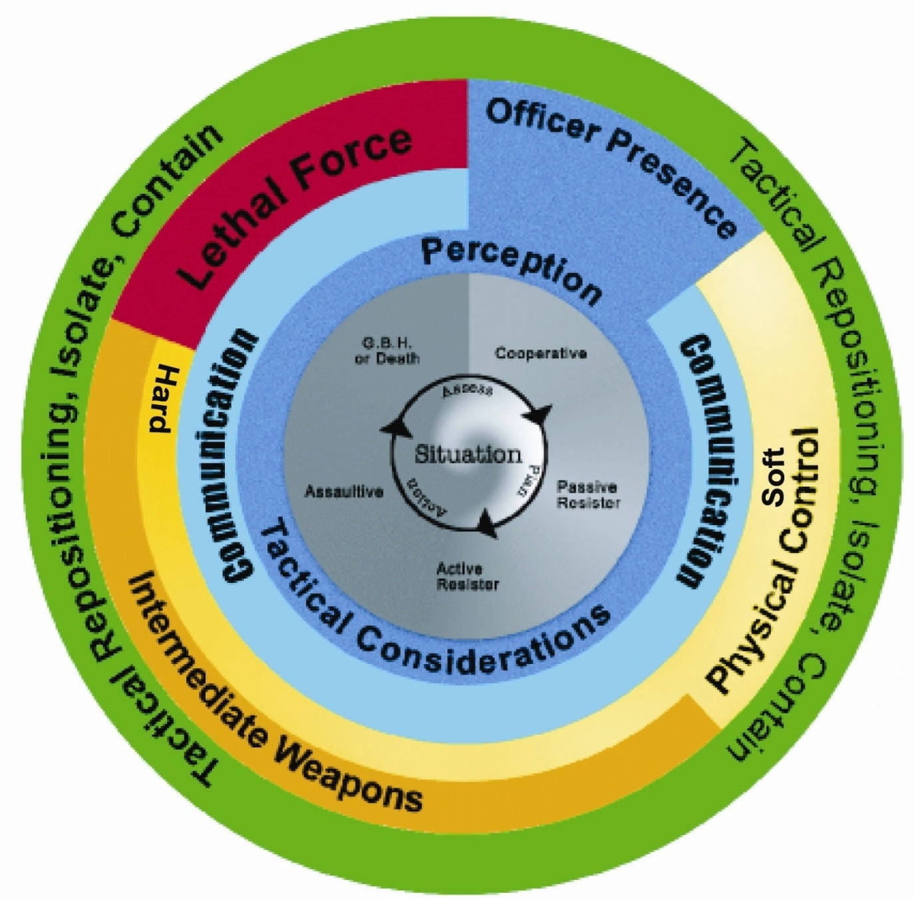
Use of Force Framework

Slide 12
Use of Force Framework
1. Our primary responsibility is to preserve life
2. Any use of force is designed to ensure public safety.
3. The Framework does not replace the law, the law speaks for itself.

Slide 13
Use of Force Framework
5. Designed based on current federal statues and current case law.
6. The Framework is not intended to dictate policy to any agency.

Slide 14
Use of Force Framework
The Framework is designed to be simple to understand and relate to public and security agencies alike.
The thought behind the Framework is based on the theory of CONTROL
The ideal outcome is to control the behavior, end violence, and surrender subjects to Police.

Slide 15
Legal Issues – Use of Force
Section 25
Everyone who is required or authorized by law to do anything in the administration or enforcement of the law
as a private person,
is, if he acts on reasonable grounds, justified in doing what he is required or authorized to do and in using as much force as is necessary for that purpose.

Slide 16
Legal Issues – Use of Force
(3) Subject to subsections (4) and (5), a person is not justified for the purposes of subsection (1) in using force that is intended or is likely to cause death or grievous bodily harm unless the person or the believes on reasonable grounds that it is necessary for the self-preservation of the person or the preservation of any one under that person’s protection from death or grievous bodily harm.

Slide 17
Legal Issues – Use of Force
Section 26
Taking into account all sections, which govern using force, this section covers excessive force. Everyone who is authorized by law to use force is criminally responsible for any excess thereof.
Anyone using force must be able to justify his or her actions. If there is no lawful justification for using force or more force is used than is necessary, then the law enforcement officer may be subject to criminal and/or civil liability.

Slide 18
Legal Issues – Use of Force
Section 27
Justifies everyone in using as much force as is reasonably necessary to prevent the commission of an offence.

Slide 19
Legal Issues – Use of Force
Section 34
In essence Sec. 37 justifies the use of deadly force, if certain conditions exist and no less violent means are available. In other words, if a person were under a reasonable apprehension of death or grievous bodily harm, they would be justified in responding with what amounts to deadly force.

Slide 20
Legal Issues – Use of Force
The phrase “grievous bodily harm” has been held to mean a bodily injury that creates a substantial risk of death, causes serious permanent disfigurement, or results in long-term loss or impairment of the functioning of any bodily member or organ.

Slide 21
Legal Issues – Use of Force
Section 37
(1) Justifies everyone to use force to defend themselves or anyone under his protection from assault, if they use no more force than is necessary.

Slide 22
Use of Force - Factors
Three Elements of Effective Force:
Was it reasonable?
Was it necessary?
Was it excessive?

Slide 23
Use of Force - Factors
Legal and effective methods of force occur when:
The method is reasonable
It is necessary
It is not overly aggressive under the circumstances presented

Slide 24
Use of Force - Factors
Reasonable
Was the level of force justified in controlling the subject?
Was the subject given a chance to comply without force?
Did the subject limit your ability to de-escalate?
With compliance by the subject, did the escalation of force become limited?

Slide 25
Use of Force - Factors
Necessary
The subject(s) did not obey commands or control tactics
Use of lower levels was not possible or ineffective
The subject presented a danger to the officer or the public and must be controlled to prevent further danger

Slide 26
Use of Force - Factors
Excessive
Did the officer use more force than was necessary, or did the use of force continue after control was achieved?
The officers actions/level or force was disproportionate to the need for action
The actions committed were based on aggression
The actions of the officer shock the conscience of the court

Slide 27
Use of Force - Factors
In order to use force, security MUST have three elements that exist:
Weapons / Means
Intent
Delivery System / Ability

Slide 28
Use of Force - Factors
Weapon
The subject can threaten with a weapon or reasonably appears capable of causing harm.
Some form of weapon must be present

Slide 29
Use of Force - Factors
Intent
The aggressor desires to cause death or grievous bodily harm to the officer or another.

Slide 30
Use of Force - Factors
Delivery System
The subject has the physical ability to carry out the threat.

Slide 31
Use of Force - Factors
If the subject(s) has demonstrated the above noted elements, the officer is justified in using the force option most appropriate to control the subject(s). There are several considerations to keep in mind when controlling the subject(s). Below are a few of the considerations:
1.Was there a lower level of force available to gain control?
2.Did or could you identify yourself as a law enforcement officer?

Slide 32
Use of Force - Factors
3.Did or could you provide the subject(s) the opportunity to de‑escalate his/her level of resistance towards you? (A warning) There is an onus on the officer, if the situation allows, to provide the subject an opportunity to de‑escalate. If the subject de‑escalates, the member must de-escalate their use of force.
4.Did you identify the proper risk before intervening accordingly?
5.Was the target isolated? What would you hit if you missed the subject?

Slide 33
Use of Force – Levels of Resistance
Law enforcement officer use of force is based on control. While in the course of their duties, law enforcement officers must often deal with subjects who exhibit all different types of behavior or levels of resistance. The level(s) of resistance exhibited by a subject determines the level of control used by the officer.
Levels of resistance are shown in the second inner circle of the Force Options Theory diagram. Although categorized for easy recognition, it is accepted that resistance levels will frequently overlap and can’t be categorized precisely.
Cooperative
Passive Resistance
Active Resistance
Assaultive
Grievous Bodily Harm or Death

Slide 34
Use of Force – Levels of Resistance
Cooperative (white) - commonly known as a “Yes” person. This individual obeys all lawful orders and direction by an officer.
Passive Resistance (light gray) - this individual does not physically interfere with an officer’s attempt at control, but does nothing to assist. Common examples of this resistance would be “dead-weight”, a protest “sit-in”, and the body going limp, refusing to leave an area and not obeying a lawful order.
Active Resistance (gray) - this individual doesn’t physically assault the officer, but actively resists in such a manner that won’t allow the officer to control. Often accompanying this type of resistance is “Verbal Non-Compliance” (refusing a lawful order or direction). Examples of this resistance are pulling away from the officer or attempting to flee.

Slide 35
Use of Force – Levels of Resistance
Assaultive (dark gray) - this individual not only resists a Law Enforcement Officer’s action, but also actually attempts to physically assault the officer. This type of resistance is sometimes preceded by “pre-assault” cues, commonly known as “Psychological Intimidation” (clenching of fists, facial expressions, threats, etc.), and verbal non-compliance. (Note: An officer would be justified to respond physically even against “pre-assault ” cues).
Grievous Bodily Harm or Death (black) - this individual violently resists. The resistance level exhibited attempts to cause grievous bodily harm or death the officer. Examples of these actions are a subject attempting to disarm a law enforcement officer where the officer fears grievous bodily harm or death or an attack with weapon the officer fears grievous bodily harm or death from.

Slide 36
Use of Force – Force Options
The Use of Force Framework identifies 5 options for force:
Office Presence
Tactical communication
Physical Control
Intermediate Weapons
Lethal Force

Slide 37
Use of Force – Force Options
Officer Presence (blue)
- appearance, uniform, reputation, physical stature, number of officers. Many people do not feel that presence is a force option, but in actual fact, a law enforcement officer’s mere presence often influences or controls a person’s behavior.

Slide 38
Use of Force – Force Options
Tactical Communication (Dialogue) (green) - verbal skills in conjunction with non-verbal skills. Suggestions, advice, directions continuing through to loud, repetitive commands, in conjunction with facial expressions, stance, eye contact, etc. Dialogue is used continually with the rest of the force options. In fact, an extremely high percentage of all encounters with offenders are resolved at this level.

Slide 39
Use of Force – Force Options
Physical Control Soft / Hard (yellow) - there are various sub-levels of force within the empty hand option. Sub-levels of force include:
Escort Position (implied force)
Superior Physical Strength (size or numbers)
Balance Displacement Techniques (throws, takedowns)
Pain Compliance Techniques (joint locks, pressure points, hair control, etc.)
Empty Hand or Weaponless Impact (stuns, strikes & kicks, using various parts of the anatomy)
Lateral Neck Restraint (rendering a subject unconscious through pressure to the sides of the neck resulting in a lack of oxygenated blood to the brain). LNR is the highest level of physical control.

Slide 40
Use of Force – Force Options
Generally speaking, physical control (or empty hand) means any physical technique the officer uses to control the subject that does not involve the use of a weapon.
Soft techniques are control-oriented and have a lower probability of causing injury. These techniques typically rely upon pain compliance such as restraining techniques, pressure points and joint/arm locks. Handcuffing would also be included in this category. These techniques are generally applicable to a subject exhibiting passive resistant and active resistant behavior.

Slide 41
Use of Force – Force Options
Hard techniques are intended to stop an aggressor’s behavior or to allow for the application of another control technique. These physical tactics include such techniques as empty hand strikes, knee strikes, punches, kicks and neck restraints. Striking large muscle mass areas would be desired target areas; however, the totality of the circumstances would always be taken into account. These techniques are generally applicable to a subject exhibiting behavior that the officer perceives as being active resistant to assaultive.

Slide 42
Use of Force – Force Options
Intermediate Weapons/Weapons of Opportunity (orange) - again there are various sub-levels in this force option. This option has relevance to modern day policing as technology is always inventing new methods for less than lethal force. Attempting to categorize each intermediate weapon would be confusing and unnecessary, as the Atlantic Police Academy Use of Force Model would become lengthy and constantly changing. This option represents an intermediate group of weapons between empty hand control and firearms. Sub-levels of force include:
Oleoresin Capsicum Spray (implied force, targeted spray)
Impact Weapons (implied force, motor dysfunction, joint strikes and deadly force strikes)
Others may include: Flashlights, portable radios, etc.

Slide 43
Use of Force – Force Options
Lethal Force (red) - this includes the sidearm, baton, and would also include any other weapon or technique used in a manner that is likely or intended to cause Grievous Bodily Harm or death. (ie: intentional punch to throat or baton strike to head)
“Law enforcement officers may use lethal force only when necessary, that is, when the officer has a reasonable belief that the subject of such force poses an imminent danger of death or grevious bodily harm to the officer or to another person.”

Slide 44
Use of Force – Force Options
Necessary (Necessity)
Necessary means no other reasonable alternative is available to you. All other available means of preventing imminent and grave danger to you or other persons have failed or would be likely to fail. There is no safe alternative to using deadly force, and without it, you or others would face imminent and grave danger of death or grevious bodily harm.
An officer is not required to place him or herself, another officer, a subject or the public in unreasonable danger of death or serious physical injury before using deadly force.

Slide 45
Use of Force – Force Options
It is important to note that these are FORCE OPTIONS not LEVELS OF FORCE. If we were to categorize options into levels of force, we would see somewhere between 17 and 35 sub-levels of force, depending upon interpretation. In fact, some sub-levels of force under the various force options are on par with others. Certain intermediate weapons actually represent a lower level of force than some empty hand control tactics (eg - O.C. Spray is considered a lower level of force than physically striking a person in an area likely to cause injury).

Slide 46
Use of Force – Summary
Legal articulation is the foundation upon which all use of force, arrest and control and Officer Safety Training is built on.
It guides an officers actions in any given situation, making sure that their actions and levels of force are justified.
Was it reasonable?
Was it necessary?
Was in excessive?
You have learned:
Levels of Control
Levels of Resistance
Criminal Code
Remember:
We are not police officers, and as such must be aware of our limitations, and not exceed them.
We are always in the public eye and must be aware of that

Slide 48
TACTICAL HANDCUFFING
Instructor:
Date:

Slide 49
OBJECTIVES
Topic: Tactical Handcuffing
Objectives: (Classroom)
Examine handcuffs and learn the different parts of the handcuffs
Discuss and explain basic handcuff maintenance
Discuss the 3 types of subjects Security Officers will face
Discuss the 3 steps taken to reduce liability

Slide 50
OBJECTIVES
Topic: Tactical Handcuffing
Objectives: (Practical)
Demonstrate proper handcuff loading
Demonstrate handcuff grips and stances
Demonstrate standing, kneeling & prone handcuffing
Demonstrate handcuff removal

Slide 51
OBJECTIVES
Method Of Instruction: Lecture development, practical application, written exam
Training Aides: Presentation, Handcuffs, practical applications, written exam
Pen and paper are required

Slide 52
Introduction
Handcuffing is one of our most commonly used tactical skills by virtue of the fact that we handcuff most subjects taken into custody. However, most law enforcement agencies do not emphasis the need to practice handcuffing skills, although the skill is “perishable”, meaning it is quickly forgotten if not practiced regularly.

Slide 53
Introduction
Regardless of whether an arrest is low or high risk, we as security officers must eventually get close enough to a subject to place them into restraints. That said, it is often difficult to predict a subjects compliance, however, one studies suggests that 68% of subjects will exhibit non-complaint behavior at the first contact of steel to wrist.

Slide 54
Introduction
Keeping that statistic in mind, it is important that an Officer must attempt these techniques from a position of control, with speed and ease of application, allowing for a technique that is versatile enough to change with the subjects level of compliance.
This allows officers to more quickly control potentially resistive subjects, averting the need to escalate the level of force used.

Slide 55
Handcuffs : History
Handcuffs have been around since medieval times when they were called shackles or manacles . The more modern versions were patented around the turn of the century.
Handcuffs are designed with three bands of metal in the rings on each cuff that are connected on a pivot joint. This allows the single blade to pass between the other two pieces and rotate 360 degrees. A ratchet connection on the single blade locks it in place. There is a second locking mechanism that keeps the blade locked in place and will not allow it to ratchet any tighter.

Slide 56
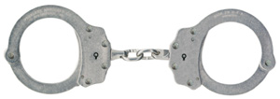
Handcuffs : Duty
Police officers use one of two common types of handcuffs. The first is a set of steel rings connected by a short chain.

Slide 57
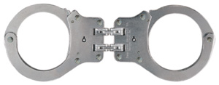
Handcuffs : Duty
The second type is called the hinge type handcuff. It uses two sets of links similar to a bicycle chain.
This allows the handcuff to bend, but not swivel. This hinders the suspects ability to move his hand around and get the handcuffs moved from the back to the front. There are also cases of very strong people breaking the link in the chain handcuffs by getting them locked at a certain angle and bending them.

Slide 58
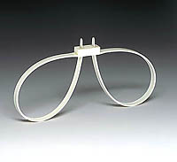
Handcuffs : Duty
Police also carry disposable handcuffs which have the same design as the common plastic ties use to tie up wiring. These disposable handcuffs are about a 25" long piece of plastic strip where one end fits into the other with a one way ratchet end. We place these around both wrists and tighten them up. This type has to be cut off at the jail. Disposable handcuffs are commonly used in situations where there are a large groups of people arrested.

Slide 59
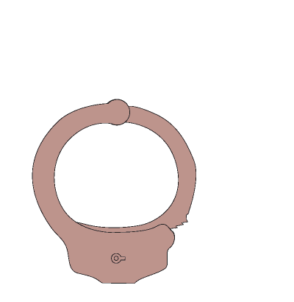
Handcuffs : How they Work

Slide 60
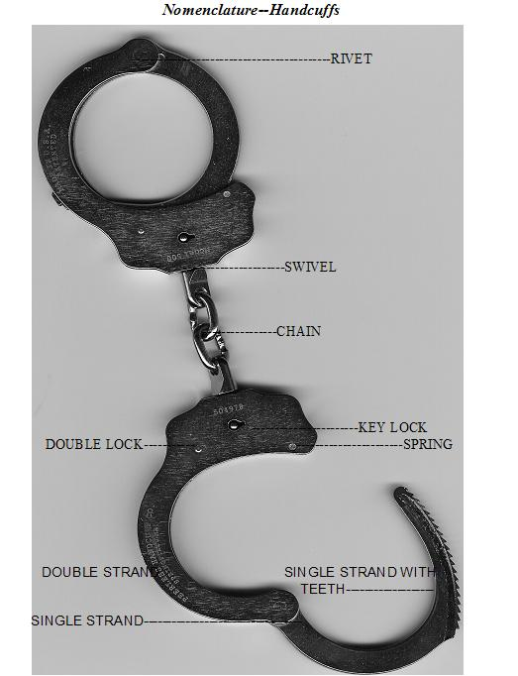
Handcuffs : Nomenclature
SINGLE BAR
DOUBLE BAR
RIVET
STRAND
SPRING
DOUBLE LOCK
LOCK
SWIVEL
CHAIN
KEY

Slide 61
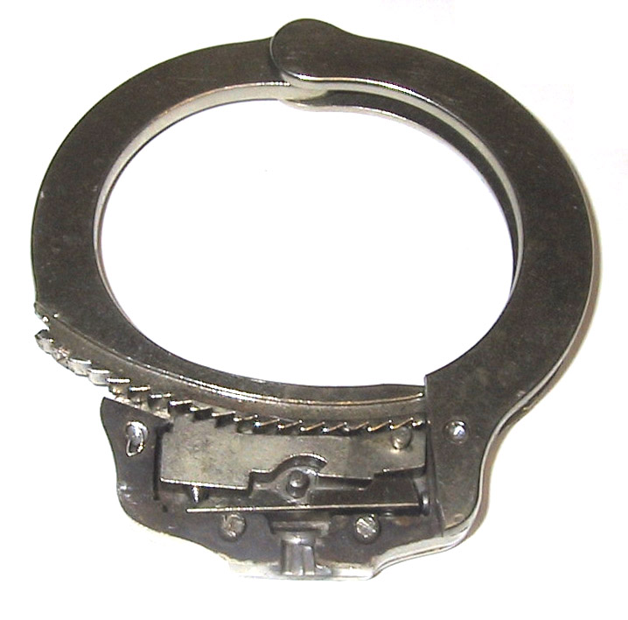
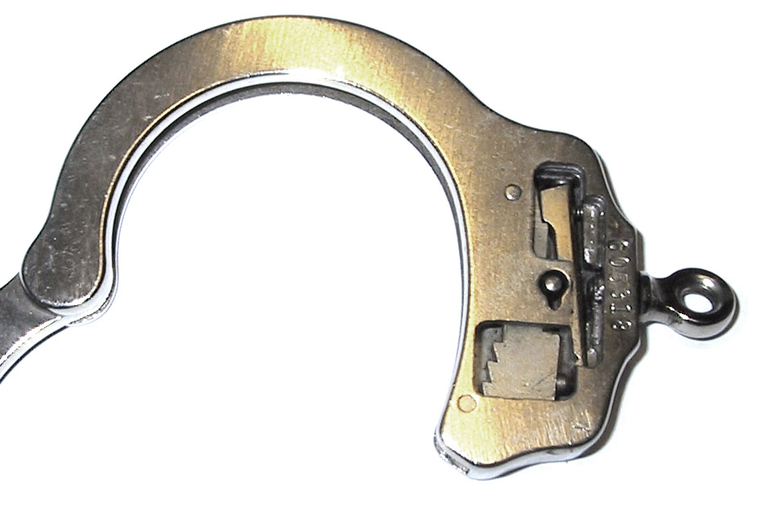
Handcuffs : Nomenclature

Slide 62
Handcuffs : Maintenance
While restraints are designed and manufactured to take abuse avoid dropping onto or banging against hard surfaces.
When possible carry your restraints in a protective case to reduce exposure to outside elements. If exposed to moisture dry thoroughly. Most importantly, dry the inside locking mechanisms.

Slide 63
Handcuffs : Maintenance
When unlocking your restraint be careful not to torque the key guide post. This will loosen the post causing it to fall out. Also, be careful not to over rotate the key causing the key flag to break off or become stuck in the locking mechanism. Use extra caution when using oversize keys.

Slide 64
Handcuffs : Maintenance
Restraints should receive regular care and maintenance. Inspect them frequently. Keep the ratchet and key hole free of dirt, lint or other foreign substances which may hinder proper functioning.

Slide 65
Handcuffs : Maintenance
Routinely clean and lubricate using Teflon based oil. Apply liberally making sure the oil has worked into the locking mechanism, double lock hole and single strand pivot area. After lubricating remove all excess oil from handling surfaces so the restraints are not slippery

Slide 66
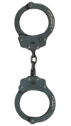
Handcuffs : Maintenance
Pentrate (black oxide) finishes may require more frequent lubrication and may tend to rust if not kept properly oiled.
If the restraints are contaminated by blood, vomit or other substances, use appropriate sterilization techniques, then dry and oil.

Slide 67
Handcuffs : Who To Handcuff?
When we handcuff someone we must take into account the “Reasonable Man Theory”
We believe, on reasonable and probable grounds that the person has committed a crime
We have the power to arrest
They present a risk to flight / escape
A safety hazard to us or themselves

Slide 68
Handcuffs : Liability Issues
We must observe three basic rules.
1. Do not strike the wrist
Use the double push principle
2. Do not over tighten
Leave small finger space (check)
Compress the fingernail to see if there is circulation
3. Double lock the handcuffs*
Prevents over tightening
*Unless tactically hazardous to do so.

Slide 69
Handcuffs : Liability Issues
Positional Asphyxia
Death as a result of body position that interferes with ones ability to breath
Restriction of the:
Chest wall
Diaphragm
Muscles of the ribcage and abdomen
Signs and Symptoms:
Labored breathing
Gurgling or gasping
Period of silence after an intense struggle
Unconsciousness

Slide 70
Handcuffs : Considerations
Tactical Considerations
Approach to contact
Approach from the weak side
Approach from their blind side
Control upon touch
Tactile touch – tells us if they move
Pre-assaultive cues
Speed of application
Handcuffs reduce the ability of the offender to continue the assaultive behavior

Slide 71
Handcuffs : Who to Handcuff?
Totally Cooperative
Routine, low risk, yes people
Still Be Alert
Potentially Un-cooperative
Most dangerous (unknown)
Usually intoxicated
May try to set you up
High risk, maybe people
Totally Uncooperative
Control first, then cuff
You can not fight and handcuff
No people

Slide 72
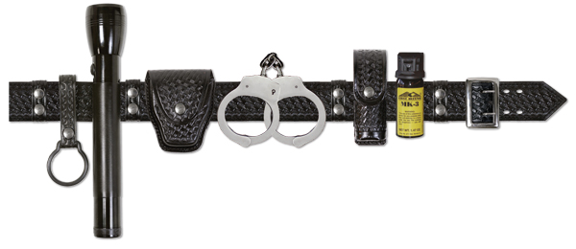
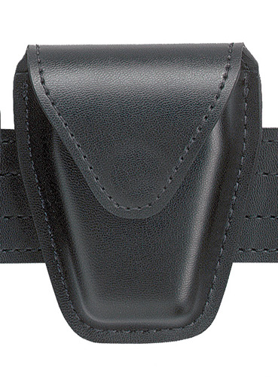
Handcuffs : Loading
NEVER PLACE YOUR CUFFS ON THE CENTER OF YOUR BACK.
SINGLE BAR SHOULD ALWAYS FACE THE CENTER OF YOUR BODY.
CUFF POUCH SHOULD BE FACE UP ON YOUR BELT.

Slide 73
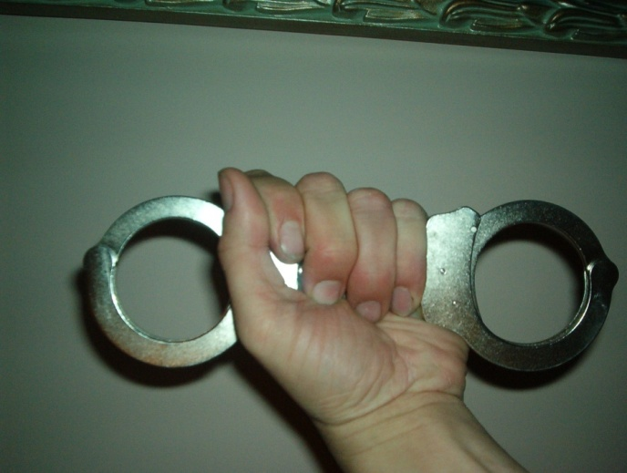
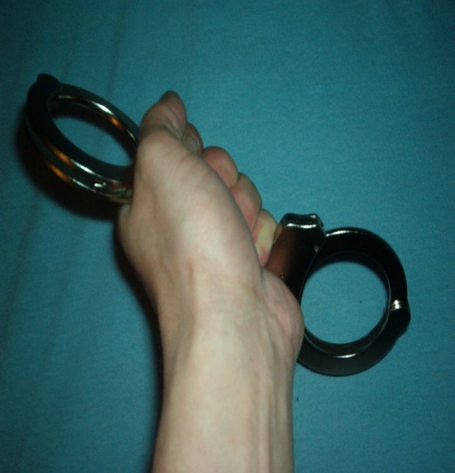
Handcuffs : Grips
Butterfly
Both cuffs are placed in your hand with the single bar facing your subject
Pistol
The top cuff single bar is pointing away from the body, the bottom cuff single bar is pointing to the side facing the center of the body.

Slide 74
Handcuffs : Approach
Always approach the subject from the 2 ½ position.
Make sure that you are six to ten feet behind the subject.
The subject should always be looking up, and away from the direction that you are approaching from.
Keep your hands above your waist and in a defensive posture

Slide 75
Handcuffs : Commands
Giving LOUD and CLEAR commands to the subjects will help in your efforts to control the situation. If the subject is unclear as to what you want him to do, it will cause confusion in the subject and make your job a lot harder. Here is a list of commands that will allow you to get the subject into the proper position for tactical speed cuffing.

Slide 76
Handcuffs : Commands
Handcuffing – Standing
Put your hands up where I can see them.
Turn around and face the other direction.
Place your ankles together / cross your ankles (dependant on balance)
Hands behind you, palms facing me
Look up, look left or right.

Slide 77
Handcuffs : Commands
Handcuffing – Kneeling
Put your hands up where I can see them.
Turn around and face the other direction.
Go down on your right knee
Go down on your left knee
Cross your feet / sit back on your feet (dependant on balance)
Hands behind you, palms facing me
Look up, look left or right.

Slide 78
Handcuffs : Commands
Handcuffing – Prone
Put your hands up where I can see them.
Turn around and face the other direction.
Go down on your right knee
Go down on your left knee
Put your right hand on the ground
Put your left hand on the ground
Walk your feet back to me
Lay on your stomach, hands out to the side like an airplane
Cross your ankles
Look up, look left or right.

Slide 79
Handcuffs : Removal
There may be some instances in which we have to remove handcuffs
Last cuff on, first cuff off
Put the subject in a position of disadvantage
Remove the first cuff and have the subject place their hand on their head
Close the cuff, maintain control of cuffs, and remove second cuff
Subject places other hand on head
Subject interlaces fingers

Slide 80
Handcuffs : Summary
We have learned:
Parts of the cuff, and basic maintenance
Discussed the 3 types of individuals Security Officers will face
The steps taken to reduce liability
How to load and hold cuffs
The basics of handcuffing from standing kneeling and prone stances

Slide 82
IMPACT WEAPONS
Instructor:
Date:

Slide 83
OBJECTIVES
Topic: Impact Weapons
Objectives: (Classroom)
Basic Baton Nomenclature
Advantages
Baton Use
Force Options Context of Impact Weapons
Primary target Areas for striking

Slide 84
OBJECTIVES
Topic: Impact Weapons
Objectives: (Practical)
Primary objective of a baton
Identify deadly force targets
Medical Considerations
Baton techniques
Baton retention

Slide 85
OBJECTIVES
Method Of Instruction: Lecture development, practical application, written exam
Training Aides: Batons, strike shields, foam batons
Pen and paper are required

Slide 86
Introduction
The baton is designed as an impact weapon that can increase an officer’s safety and temporarily incapacitate a high-level resistant subject.
The baton is not designed to “inflict punishment”, or cause permanent injury, unless the officer faces threats of grievous bodily harm or death
Baton is an intermediate force option that works on a scale based on the level of resistance presented by the offender.

Slide 87
Our System
We use a basic baton system to ensure all officers are trained to an equal level. It includes:
Consistent application
Professional and controlled conduct
Trained response vs. panic
Tactically, legally and medically acceptable

Slide 88
Our System
Components Emphasized:
Minimal threat to the officer
Initiate a reactionary gap
Delivery of strikes with maximum power when appropriate
Motor points vs. Joints
Minimize Threats:
Change the line of aggression
Avoid meeting force head on
Dynamic Movement

Slide 89
Baton Characteristics
Available in various lenghts, most common are 16, 21 and 26 inches
Consists of telescoping tubes held open by frictions locks through centrifugal force.
Opens by extension of arm and flicking of wrist
Close baton with a sharp tap to a hard surface – do not be gentle

Slide 90
Nomenclature

Slide 91
Advantages
Concealable, both uniformed and LPO
Always with the officer
Low Maintenance
Greater striking force produced than striking techniques
Noise of opening – psychological
Can be used in open & closed modes

Slide 92
Disadvantages
Will not open or stay open if not maintained
Officer Presence minimized

Slide 93
Reasons for Baton Use
Batons provide a distance advantage
Expandable batons extend reach
Striking with a baton reduces potential injury to the officer
Batons increase striking power of officer and target selection is better

Slide 94
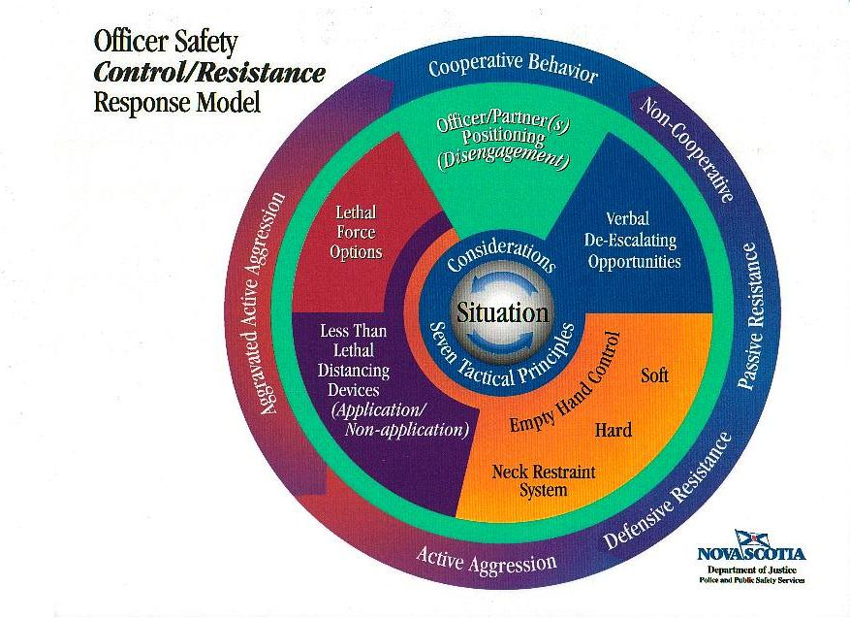
Use Of Force Context
Impact Weapons

Slide 95
Use Of Force Context
Used as a multiples level compliance tool (open / closed / low / high levels of resistance) intermediate weapon
Used on a scale of escalation determined by subject resistance
Fits between empty hand control tactics and firearms
Should only be used when:
Lower levels of force are ineffective or inappropriate and the use of high levels of force are not justified or appropriate

Slide 96
Scale Of Escalation
There are 4 levels of Escalation
Implied
Motor disfunction / brusing
Baton Contact with bones
Deadly force targets

Slide 97
Scale Of Escalation
Implied
Components of presence, verbal and non-verbal dialogue

Slide 98
Scale Of Escalation
Motor dysfunction / bruising
Fluid Shockwave principle
Primary objective of baton: create motor dysfunction to gain control over resistive subject
Nerve Motor Points
Expected Effects:
Motor dysfunction
Mental Stunning
High levels of pain
Balance Displacement

Slide 99
Scale Of Escalation
Baton Contact with bones – joints / breaking
Higher escalation of force
May Include:
Hands
Wrist
Elbow
Knee
Shin
Ankle
Foot

Slide 100
Scale Of Escalation
Baton Contact with bones – joints / breaking
Medical Consideration
High Potential for injury
Breaking bones
Soft tissue damage
Connective tissue damage

Slide 101
Scale Of Escalation
Deadly force targets (areas to avoid unless you are justified in using Lethal Force
Spine
Neck
Abdomen
Clavicle
Kidneys On
Throat
Head
And
Testicles

Slide 102
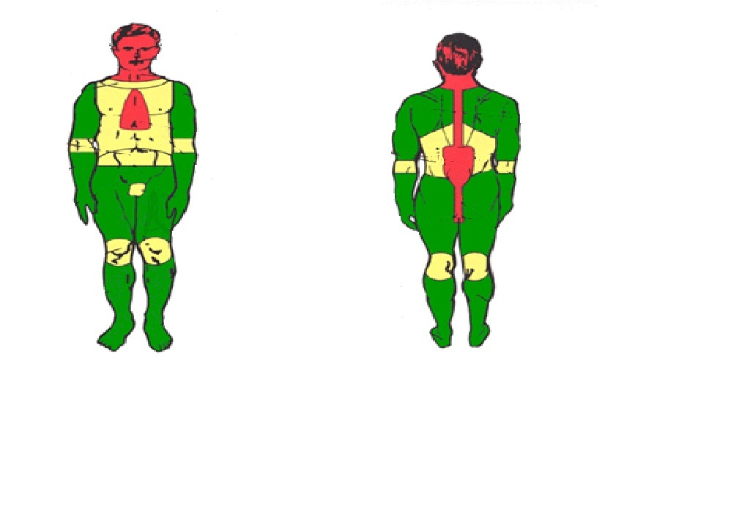
Scale Of Escalation

Slide 103
Scale Of Escalation
Deadly force targets (areas to avoid unless you are justified in using Lethal Force
Medical Considerations:
High probability of causing death or serious bodily harm

Slide 104
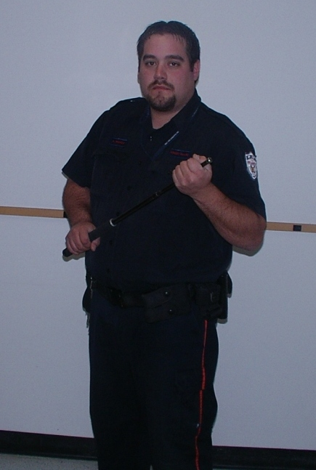
Stances
High Profile Stance

Slide 105
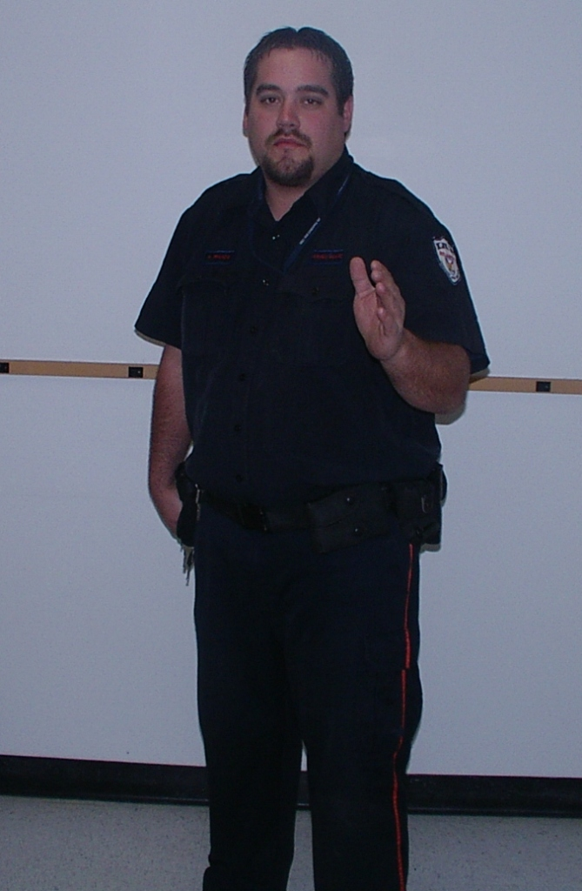
Stances
Low Profile Stance

Slide 106
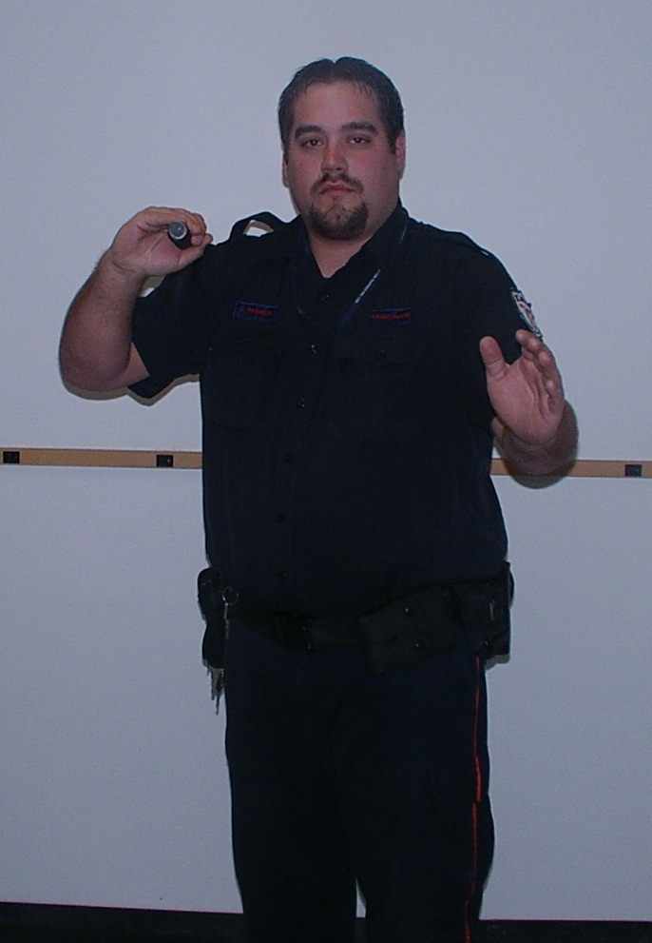
Stances
PPCT Ready Stance

Slide 107
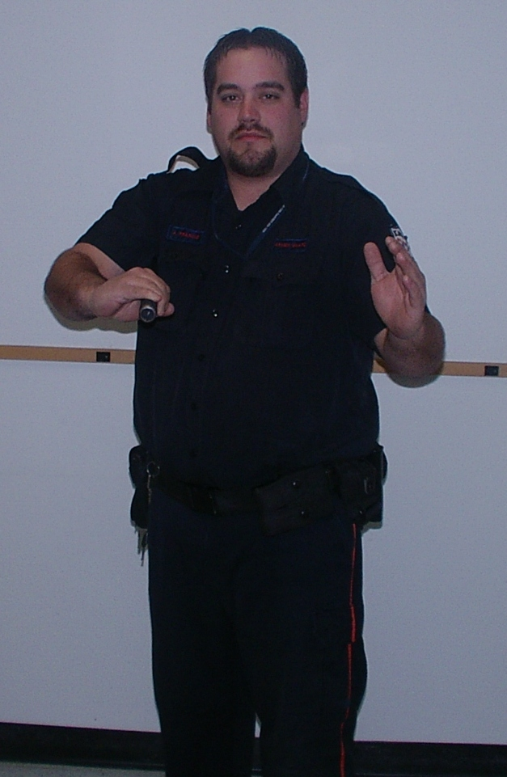
Stances
Spring Loaded Stance

Slide 108
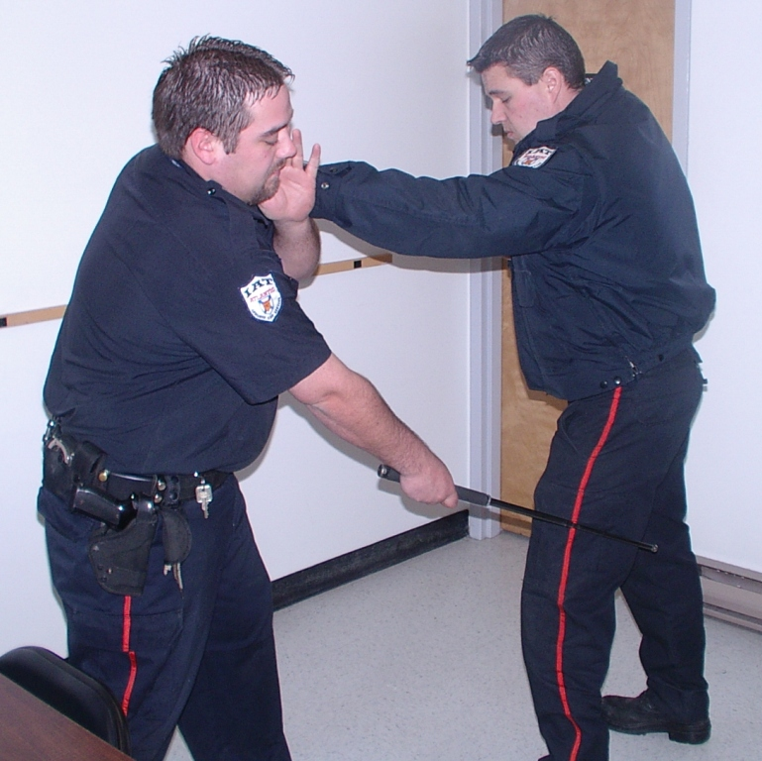
Strikes
Forward Fluid Shockwave Strike (remain on target for ¾ second)

Slide 109
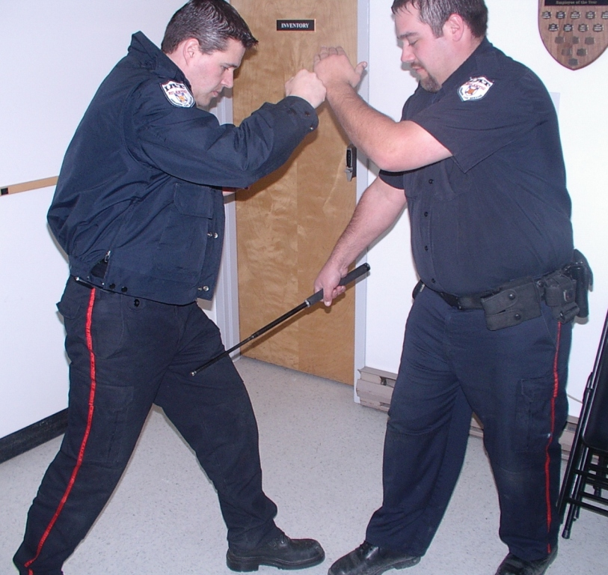
Strikes
Backhand Cutting Strike

Slide 110
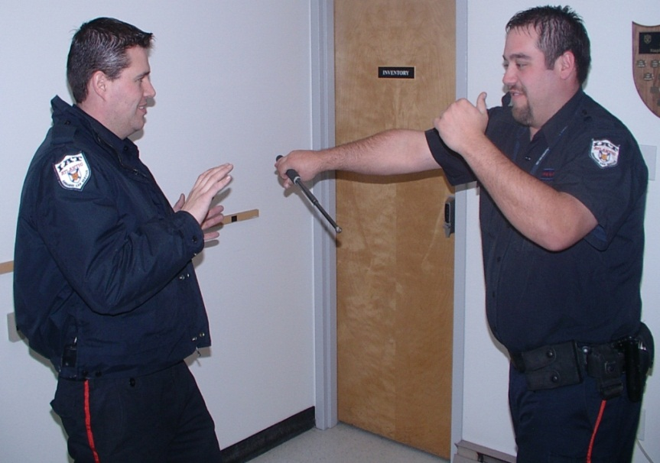
Strikes
Spring Loaded Strike

Slide 111
Striking Points
We have 5 primary striking points:
Middle of outer thigh
Middle of inner thigh
Middle of calf muscle
Middle of inner forearm
Upper outer forearm

Slide 112
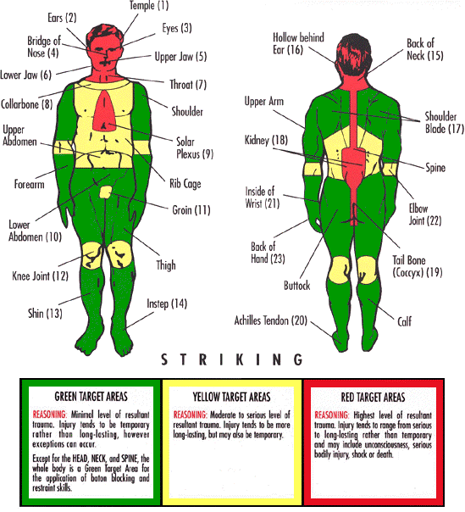
Striking Points

Slide 113
Baton : Summary
We have learned:
Baton Nomenclature
Advantages / disadvantages
Medical considerations
Scale of escalation
Stances
Strikes
Targets

